Slide 1
Sticks Kebob
Group 3
Jacob Dineen, Ruben M Suzara, Micaela Geiman, Samuel Harvey, Fiona Erickson

Slide 2
How Do people Choose Fast Food?
The owners of Sticks describe their customers as people in their 30’s who have a smartphone that want healthy and satisfying food. The foundation of the data skewed more towards women making smart dining decisions for their families. Sticks does draw a large crowd of single and professional customers in their 20’s-40’s during the lunchtime rush. Sticks seems to be focusing more on a demographic of people that want a healthier and satisfying menu for their quick service restaurant.
Location, Price, Assortment, and the quality of the food are all important factors in prospecting new customers, as well as retaining long term relationships with existing customers. Not every segment of a QSR (Quick Service Restaurant) is concerned with the same factors, stressing the importance of ‘different strokes for different folks’. Health conscious individuals will search for offerings that best fit their ideals, while people on a time crunch may not focus as much on health benefits as they are on making it to work in time. The same can be said for price – Undoubtedly, some will be more attracted to dollar menu offerings to save money, but high HH Income segments will likely disregard price consciousness for accessibility and ease of access. The best approach is to identify each of your respective customer segments and determine what matters to them. With that information you can tailor product offerings and marketing in a manner that isn’t exclusive to a particular subset of individuals.

Slide 3
Sticks Customer Vs NonCustomer
Is Customer
HH Income = $50,000-$100,000
Age: Mainly 26-40
Mostly Female.
Family.
More trouble controlling spending.
2x more likely to be a ‘business professional’
More likely to have children in a wide variety of activities.
More likely to engage in outdoor activities as hobbies.
More likely to use coupons at a restaurant.
More likely to have loyalty card rewards.
Top Alternative Restaurants:
Panera
Chipotle
Is Not Customer
HH Income = Under $50,000
Age: Slightly older than Sticks Customers
Mostly Female.
Family.
More likely to eat lunch at home.
Encourage purchase of locally produced products.
3x more likely to be a ‘homemaker’.
Top Alternative Restaurants:
McDonalds
Choosing K
Adding additional clusters after 5 does not add additional information, however, going from three to four clusters does not yield any additional information either. Analysis will be conducted with K = 3.

Slide 4
What survey questions would you use to identify the customer segments?
What is your gender/ age?
Please indicate how important the following factors are when you visit a restaurant
Convenient place to eat
Variety of menu options
Good value for money
Healthy menu options
Food taste and satisfaction
Friendly staff
Pleasant ambiance
Consistency /reliability
Part of community
How many times in the last week did you do the following?
Make and eat lunch at home
Bring own lunch to work
Buy lunch at workplace (e.g., cafeteria)
Buy lunch at a restaurant / food court / food truck
Skipped lunch / ate a small snack item
Age and gender will help us identify what demographics are shopping in the area
What’s important to the customers when they visit a restaurant will allow us to collect data to see what each segment is interested in and help us identify factors we should focus on when opening a new location
The last question will allow us to collect data on what type of people are in the segments, for example working/busy people, if they eat at home or bring their own lunch this could tell us they may be price sensitive, also if they eat small snacks it could be because they’re really busy and don’t have time or they would like to see snack size items on the menu. Either way this question tells us a lot about the consumers in the area.

Slide 5
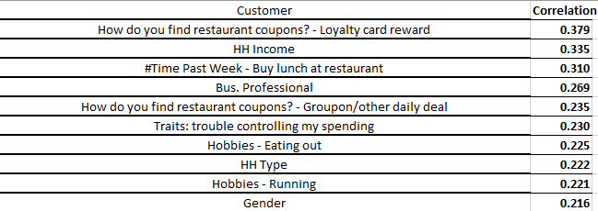
Feature Importance
There are 67 features, besides the binary response variable of IsCustomer, that define each observation. Initial K means computation yields 3 separate clusters, each containing customers and non customers of Sticks Kebob, as well as their psychographic and demographic identifiers.
Correlation doesn’t suggest causality, but does lend a hand to which variables share relationships. Some of the positively correlated features from the dataset, in terms of their relationship with our IsCustomer Variable are (This may not be relevant to later analysis):
Data appears to have excess collinearity, evidenced by pushing the whole dataset through a logistic model on XLSTAT. Most features were removed.
As seen to the right, there is a fairly uniformed dist. between customer and noncustomers.

Slide 6
Survey Segments
K = 3, so we have three separate customer segments drawn from the survey data. As with clustering, the goal is to minimize the distance from observations within each cluster, and maximize the distance between clusters.
Segment1: Mostly noncustomers. They prefer to eat lunch at home rather than eat out. They find themselves more concerned with community than other segments. They have the lowest HHIncome and HHType (single/family) of the three clusters, and contain a slightly higher sample of males, but still skew overwhelmingly female. This segment prefers locally produced products. Mosty notably, this segment distinguishes itself from the other two because only on person listed ‘Eating out’ as a hobby.
Segment2: Mostly Customer. This segment contains an audience that compiles a larger HHIncome and HHType than the other clusters. They are more likely to have children under the age of 12 who are heavily involved in activities Coupled with the fact that this segment notes the highest raw count of professionals leads us to the assumption that time is a concern for this audience. They are more engaged in outdoor/physical activities as hobbies, and are also bargain hunters, using coupons more than not.
Segment3: A mixture of both classes, this appears to be an untapped market. Most attribute features fall within the first two segments, but there is a high propensity for ‘eating out’ as a substitute for home cooking.
Who Should Sticks Target?
If Sticks is trying to acquire/prospect new customers to add to their existing customer base, they should target segment 2, as they are most likely to be future customers. If Sticks was trying to lure customers away from competitors, they’d likely have success at targeting segment 3, who show psychographic and demographic traits more inline with existing Sticks Customer.

Slide 7
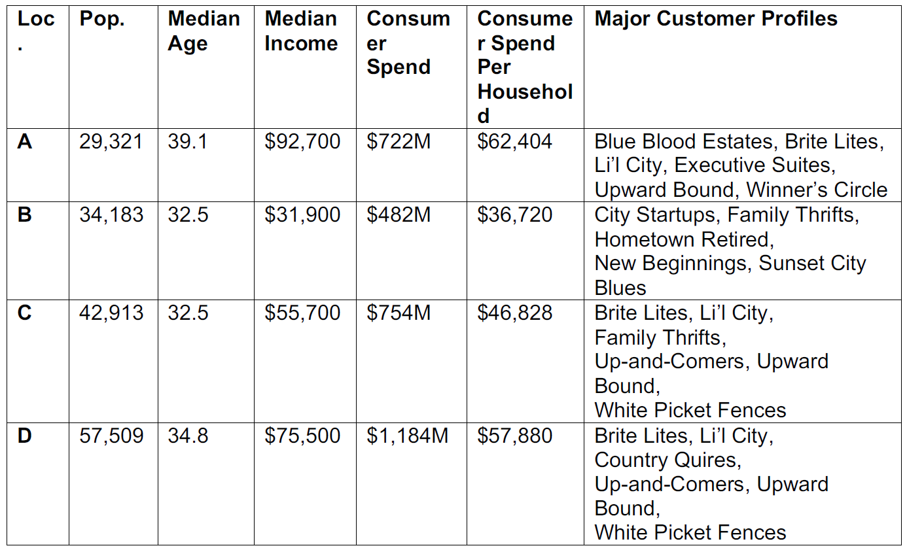
Recommendation on New Location
Based on the table to the right (provided in the syllabus), our next location should be either A or D. Both sets of data coincide with the groupings of our cluster analysis, with A being more oriented to Business Professionals, and D being a slightly younger audience with younger children and a level of disposable income that Loc B and C segments don’t posess.
It is although worth noting that the data tells us that Loc D has the highest consumer spend potential, speaking to the size of the untapped market.

